Slide 1


Slide 2
A PROJECT ON NEW EVOLUTIONARY LEARNING APPROACHES FOR FEATURE SELECTION ON BIOMEDICAL DATA
Project Created by :
Group No : 8 Semester : 7th Year : 4th
Bachelor of Technology
Computer Science and Engineering(Assistant Professor/Professor)
Asansol Engineering College
Guided and Supervised By : Mr. Sabyasachi Mukherjee
Group Members :
Name | Roll No.
1. Aparna Mahato | 10800118116
2. Anwesha Dey | 10800118117
3. Sanraj | 10800118056
4. Rahul Prasad | 10800118074

Slide 3
SKILL USED : MACHINE LEARNING PROGRAMMED IN : PYTHON PLATFORM USED : JUPYTER NOTEBOOK LIBRARIES USED : NUMPY PANDAS SCIKIT LEARN MATPLOTLIB SEABORN

Slide 4
INTRODUCTION
Breast cancer is one of the most common cancers among women worldwide, representing the majority of new cancer cases and cancer-related deaths according to global statistics, making it a significant public health problem in today’s society.
The early diagnosis of Breast Cancer can improve the prognosis and chance of survival significantly, as it can promote timely clinical treatment to patients. Further accurate classification of benign tumors and malignant tomours can prevent patients undergoing unnecessary treatments.
Thus, the correct diagnosis of Breast Cancer and classification of patients into malignant or benign groups is the subject of much research. Because of its unique advantages in critical features detection from complex Breast Cancer datasets, machine learning (ML) is widely recognized as the methodology of choice in Breast Cancer pattern classification and forecast modelling.
Objective of this paper is to apply ML algorithms to classify breast cancer outcomes using a small publicly available data set.

Slide 5
MACHINE LEARNING : INTRODUCTION
Machine learning is
•a branch of artificial intelligence
•employs a variety of statistical, probabilistic and optimization techniques
•allows computers to “learn” from past examples
•detect hard-to-discern pattern from large, noisy or complex data .
The goal of ML is to develop algorithms which can learn and improve over time and can be used for predictions. Most ML researchers concentrate on automatic machine learning (aML), where great advances have been made.
Particularly, probabilistic ML is extremely useful for health informatics, where most problems involve dealing with uncertainty.
Here , we build automated models those have high accuracies in detecting and classifying benign cells and malignant cells thus greatly easing the process of diagnosing breast cancer nowadays.

Slide 6
MACHINE LEARNING ALGORITHMS USED
1.Logistic Regression – to predict the probability of the target event.
2.Decision Tree – to create a training model that can use to predict the class or value of the target variable by learning simple decision rules inferred from prior data(training data).
3.Random Forest – multiple Decision Trees with random samples and random attributes. (ensemble method).
4. Feature Selection – Method used is Filtering where the raw dataset is cleaned up and made rid of irrelevant or null values to get the maximum accuracy during the model training.

Slide 7
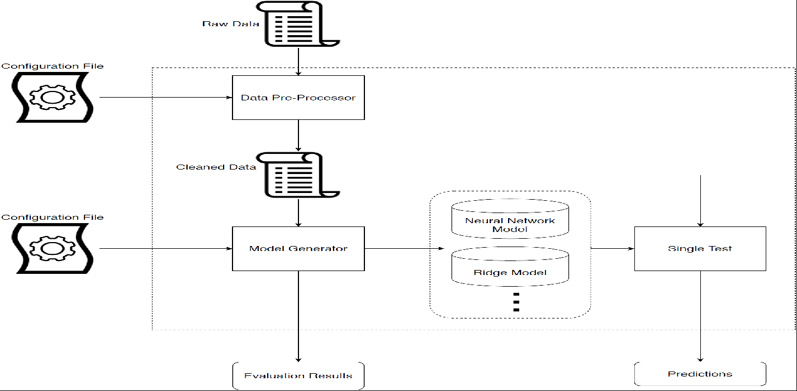
BREAST CANCER DETECTION PROCESS FLOW
Logistic regression
Decision tree

Slide 8

LOGISTIC REGRESSION ALGORITHM

Slide 9

DECISION TREE ALGORITHM
Decision Tree is a Supervised learning technique that can be used for both classification and Regression problems, but mostly it is preferred for solving Classification problems. It is a tree-structured classifier, where internal nodes represent the features of a dataset, branches represent the decision rules and each leaf node represents the outcome.
In a Decision tree, there are two nodes, which are the Decision Node and Leaf Node. Decision nodes are used to make any decision and have multiple branches, whereas Leaf nodes are the output of those decisions and do not contain any further branches.
The decisions or the test are performed on the basis of features of the given dataset.
It is a graphical representation for getting all the possible solutions to a problem/decision based on given conditions.
How does the Decision Tree algorithm Work?
In a decision tree, for predicting the class of the given dataset, the algorithm starts from the root node of the tree. This algorithm compares the values of root attribute with the record (real dataset) attribute and, based on the comparison, follows the branch and jumps to the next node.

Slide 10
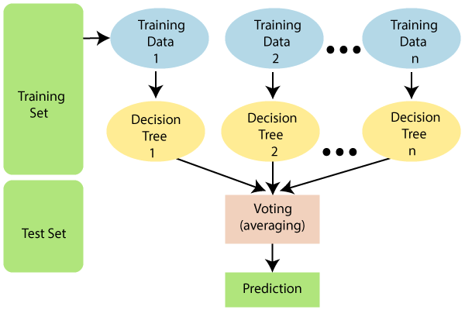
RANDOM FOREST ALGORITHM
Random Forest is a popular machine learning algorithm that belongs to the supervised learning technique. It can be used for both Classification and Regression problems in ML. It is based on the concept of ensemble learning, which is a process of combining multiple classifiers to solve a complex problem and to improve the performance of the model.
As the name suggests, "Random Forest is a classifier that contains a number of decision trees on various subsets of the given dataset and takes the average to improve the predictive accuracy of that dataset." Instead of relying on one decision tree, the random forest takes the prediction from each tree and based on the majority votes of predictions, and it predicts the final output.
The greater number of trees in the forest leads to higher accuracy and prevents the problem of overfitting.

Slide 11
FEATURE SELECTION (FILTERING)
While building a machine learning model for real-life dataset, we come across a lot of features in the dataset and not all these features are important every time. Adding unnecessary features while training the model leads us to reduce the overall accuracy of the model, increase the complexity of the model and decrease the generalization capability of the model and makes the model biased. Even the saying “Sometimes less is better” goes as well for the machine learning model. Hence, feature selection is one of the important steps while building a machine learning model. Its goal is to find the best possible set of features for building a machine learning model.
Filter Method:
These method is generally used while doing the pre-processing step. These methods select features from the dataset irrespective of the use of any machine learning algorithm. In terms of computation, they are very fast and inexpensive and are very good for removing duplicated, correlated, redundant features but these methods do not remove multicollinearity. Selection of feature is evaluated individually which can sometimes help when features are in isolation (don’t have a dependency on other features) but will lag when a combination of features can lead to increase in the overall performance of the model.

Slide 12
WORKFLOW PROCESS
Loading Libraries and Dataset – Python libraries are imported and using pandas , the dataset is loaded as a dataframe.
Feature selection from the dataset – Filtering is done to remove the null values from all the rows and columns. And we got a new fresh dataset.
Value Counts – From the ‘diagnosis’ feature , total no of benign and malignant cases are counted. We see that our dataset is imbalanced having more no of benign than malignant.
Data Visualization – Using Seaborn libraries, the categorical values are visualized in the form of graphs.
Data preprocessing – Using scikit learn, the fresh data is preprocessed and labelled into two binary values (1 for cancerous or malignant and 0 for benign). Then correlation heatmap is plotted for each pair of features to visualize the impact of the features.

Slide 13
CONTINUED…..
Splitting Dataset – Using scikit learn ,75% data is splitted for training the model and rest 25% for testing purpose.
Model Training – The model is trained using 3 different supervised learning algorithms(Logistic Regression, Decision Tree, Random Forest). Accuracy is calculated for the training models. We found Decision gave the highest accuracy in this training.
Confusion Matrix – From sklearn , confusion matrix is formed for 3 algorithms and testing accuracy is calculated . Here we found Random Forest gave the highest accuracy over the other two.
Random Forest Prediction – Finally we preferred Random Forest Classifier for Breast Cancer Prediction and once again predict the result for our test datasets and and get it in binary formats.

Slide 14
CONCLUSION
This study identifies Random Forest model to be most successful in breast cancer classification. (96.5% accuracy rate, and the least number of fault predictions)
concave_points_worst and perimeter_worst are the most important features for classifying breast cancer outcomes.
Our results show that ML algorithms can classify breast cancer outcomes with high accuracy and identify key characteristics even for small datasets.
We highlight the significant potential in using ML techniques as a diagnostic tool for early detection of breast cancer in general.

Slide 15
THANK YOU

